Slide 1
Developing Smart Study Skills
Getting the Best Possible Results

Slide 2
Study Tips
Set a regular time to study
Remove all distractions
Have all the necessary supplies
Clear a TABLE in a Quiet place to study

Slide 3
Find a Good Place to Study
This means a desk with nothing on it except the subject that you are STUDYING
Have a regular time and place for studying

Slide 4
Make sure you have the following
Solid flat surface for writing
Good lighting
Chair
Books
Supplies
Clock
Drink

Slide 5
Before you begin studying
Eat
Break
Have a plan
Have all the materials for that subject
Computer, if necessary

Slide 6
Rewrite notes to study
Some people like to underline and highlight important ideas and vocabulary
Stop looking for excuses NOT to study!!
Think about the END goal – your Exam – What will you be doing after it!!!

Slide 7
Change Habits
Form a good listening habit – good listening in class
Concentrate on what is going on – try and avoid daydreaming
You can not listen if you are talking!!

Slide 8
Use your time wisely
Get a Study Timetable
Stick it on the wall over your table
Get your exam Timetable and stick it up on the wall
Think about ‘dead’ time – how can you use it more effectively

Slide 9
Help Each Other
Liaise with class mates and see if you can get some notes and swap/share notes
Look up websites, ask teachers

Slide 10
How to get the best possible results
KNOW the exam papers
Review Mock Papers – spend time doing up these answers again

Slide 11
Be a Smart Learner
The key to study is learning to be a smart learner – exam questions, exam papers!!
Using your time effectively – make a timetable
Take time to Study

Slide 12
Brain Foods
Choosing the right food and drink will make it easier to concentrate and perform better in exams
Everyday
Breakfast Fish
Oranges Berries
Water Raisins
Healthy snacks Some treats i.e chocolate/crisps
Eggs Cheese

Slide 13
During exam weeks
Water
Fresh fruit smoothies
Fresh or dried fruits
Unsalted nuts
Sandwiches
Soup
Yoghurts
Cheese

Slide 14
Day of an Exam
Eggs/beans/mushrooms on toast
Porridge/muesli/weetabix
Bananas, raisins or a fruit smoothie
Later on try high protein foods
Beans, Meat, Fish, Eggs or Cheese
Vegetables and fruit

Slide 15
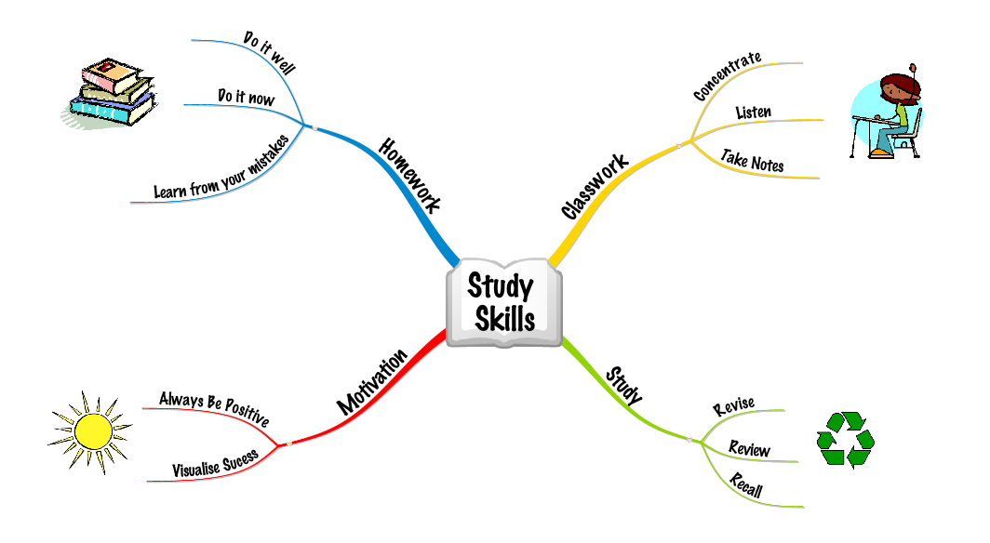
Use a Mind Map

Slide 16
Mind maps are good for connecting your knowledge and deepening understanding. The brain remembers a visual differently than written and both together enhance retention of the content
Can be used in the exam to help you structure your answer

Slide 17
Keys to Study
Time Management
Organisation
Note taking
Concentration

Slide 18

Remember your predicted Results………

Slide 19
Some links that may help…
For English
www.sparknotes.com
www.cliffnotes.com/WileyCDA/
For Irish
www.focal.ie/Home.aspx
In general
www.skoool.ie
www.examinations.ie

Slide 20

Why don’t you think……..

Slide 21
http://www.youtube.com/watch?v=SbJIi6nUs2s

